Slide 1

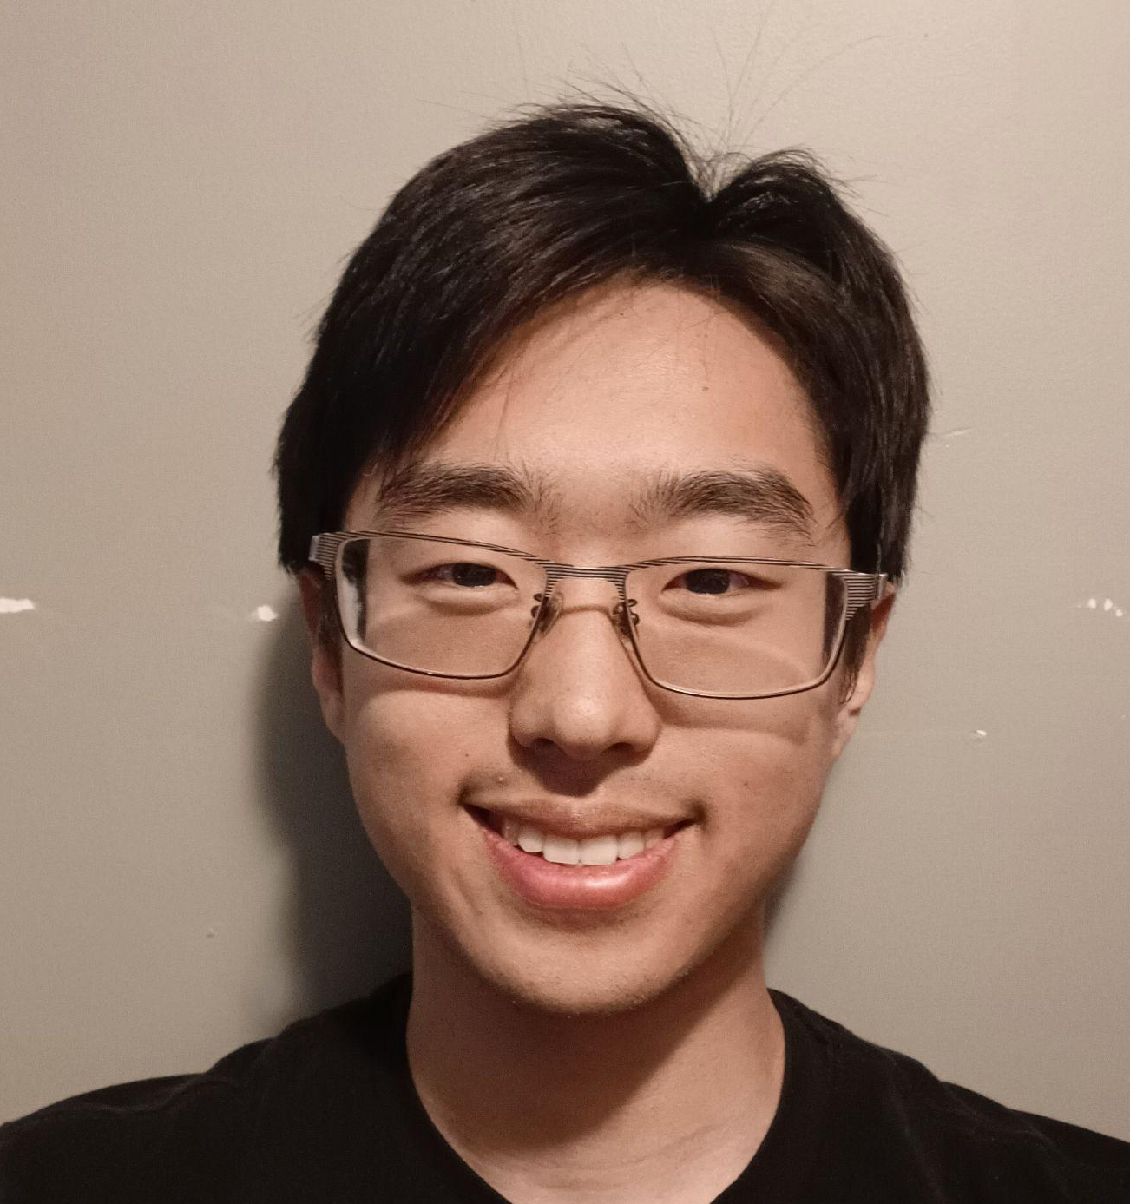
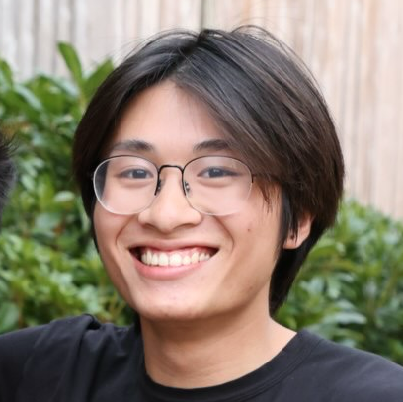

Transforming Education: Smart Tutors Collective
Hackathon
Team 8
Venkatesh Appala
Chanseok Oh
Evan Lam
MS in CS @ UW
Sreya Sukhavasi
Principal TPM @ Wheels Up
Undergrad in CS @ UW
Software Engineer @ Nordstrom
Problem Statement 3: AI Agents for Personalized Learning & Tutoring
Empowering Every Student Through AI

Slide 2
Agenda
Problem Statement and Solution Approach
Key Features & Demo
Architecture Overview
Challenges and Learnings
Future Enhancements
Flow Diagram Reference

Slide 3
Problem Statement & Solution Approach
Identifying the Problem
Proposed Solution
One-Size-Fits-All Approach
Traditional education systems often ignore individual learning paces, leading to disengagement and knowledge gaps among students.
Lack of Real-Time Adaptability
Real-time adaptability is a challenge for current personalized learning, delaying feedback and hindering effective learning.
Develop an AI-powered multi-agent tutoring system that tailors educational content and interactions based on each student’s strengths and preferences.
Smart Tutors Collective is a web app powered by AI agents, offering personalized and interactive learning experiences. Users can explore subjects and learning paths, take quizzes to assess their strengths and weaknesses, and receive tailored recommendations for books and learning paths. It's a comprehensive solution for engaging and adaptive education.

Slide 4
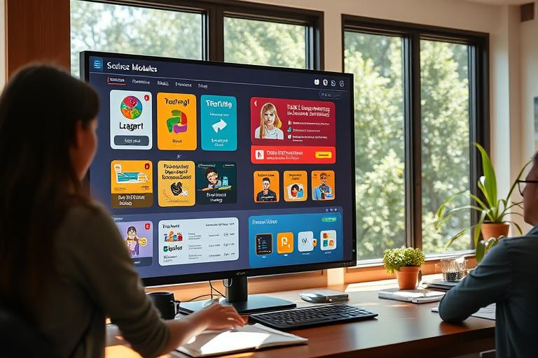
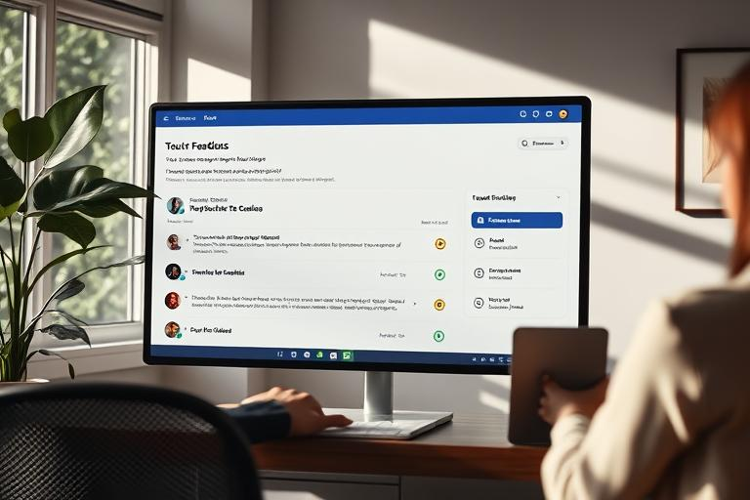
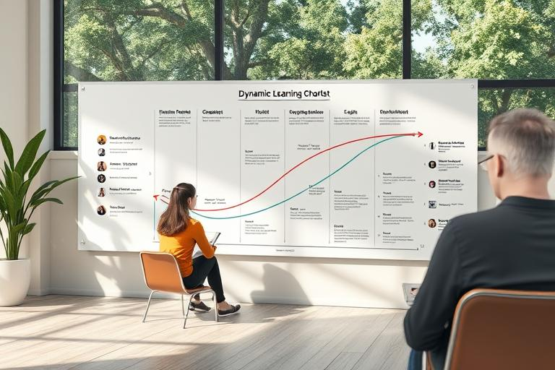
Key Features
Interactive User Interface
Real-Time Feedback
Adaptive Learning Paths
The interface provides an engaging experience with easy navigation and access to different tutoring modules.
Students receive instant feedback on their answers, helping them to learn from mistakes immediately.
AI agents create personalized learning paths based on student strengths and weakness ensuring tailored education.
Smart Tutors Collective simplifies interactions with AI agents by integrating them into intuitive web components. The AI agents analyze user input to deliver a range of personalized and interactive features, including:
Subject Exploration: AI-guided research offering curated insights on chosen topics.
Adaptive Quiz Creation: Quizzes are dynamically tailored to the user's grade, age, and proficiency level.
Knowledge Analysis: Personalized evaluations highlighting strengths and areas for improvement.
Resource Recommendations: Tailored suggestions for books and learning paths to deepen learning.
Focused Practice Paths: Sub-topic suggestions with specialized quizzes to target specific learning areas.
This streamlined approach empowers users to engage with AI-driven, adaptive learning in a meaningful and efficient manner.

Slide 5
Recorded Demo
https://bit.ly/smarttutorsdemo
https://github.com/SeattleDataAI-Hackathon/SDAIC-Hackathon-Team-08

Slide 6
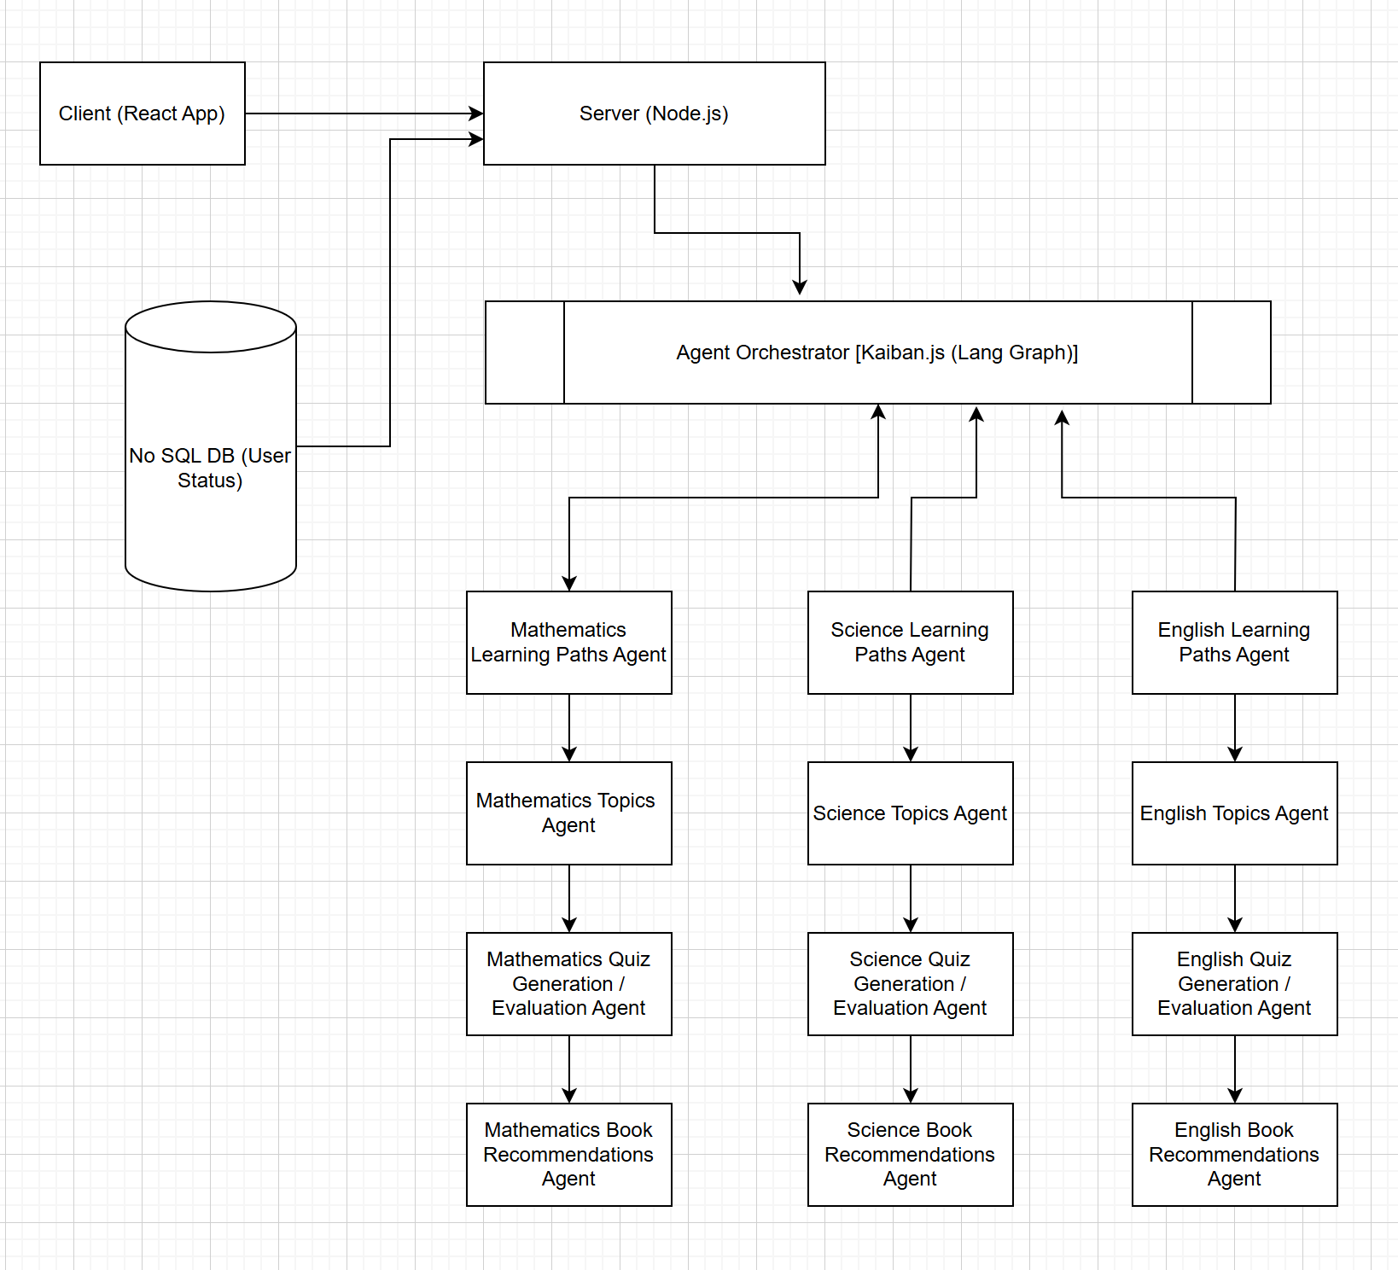
Architecture Overview

Slide 7
Challenges
Adaptation / Growth
Challenges and Adaptation/Growth
Unfamiliar technologies and challenging objective.
The team quickly learned these technologies, and took up different roles when needed.
01
Difficult path from ideation to execution with AI agents.
Refined prompt engineering enabled AI agents to create personalized quizzes and produce efficient recommendations tailored to users' needs.
02
Integration issues arose when combining front-end components with Agent code.
Debugging these challenges not only resolved the issues but also deepened our understanding of system interactions and enhanced our problem-solving skills.
03

Slide 8
Future Enhancements
Expand Subject Coverage: Incorporate niche areas such as coding and arts to broaden learning opportunities.
Enhance Analytics: Improve real-time data analytics for comprehensive student performance tracking and insights.
Develop Mobile Applications: Create mobile-friendly apps to provide learning on-the-go and increase accessibility for users.
Integrate Textbooks: Add textbooks to the database to enrich quizzes and enhance agent interactions with book-specific knowledge.
Adaptive Learning Paths: Implement dynamic learning paths that evolve based on student progress and needs.
Community Platform: Build a collaborative platform to encourage peer-to-peer learning and support.
Refine AI Tutors: Leverage machine learning to continuously optimize AI tutor effectiveness and responsiveness.

Slide 9
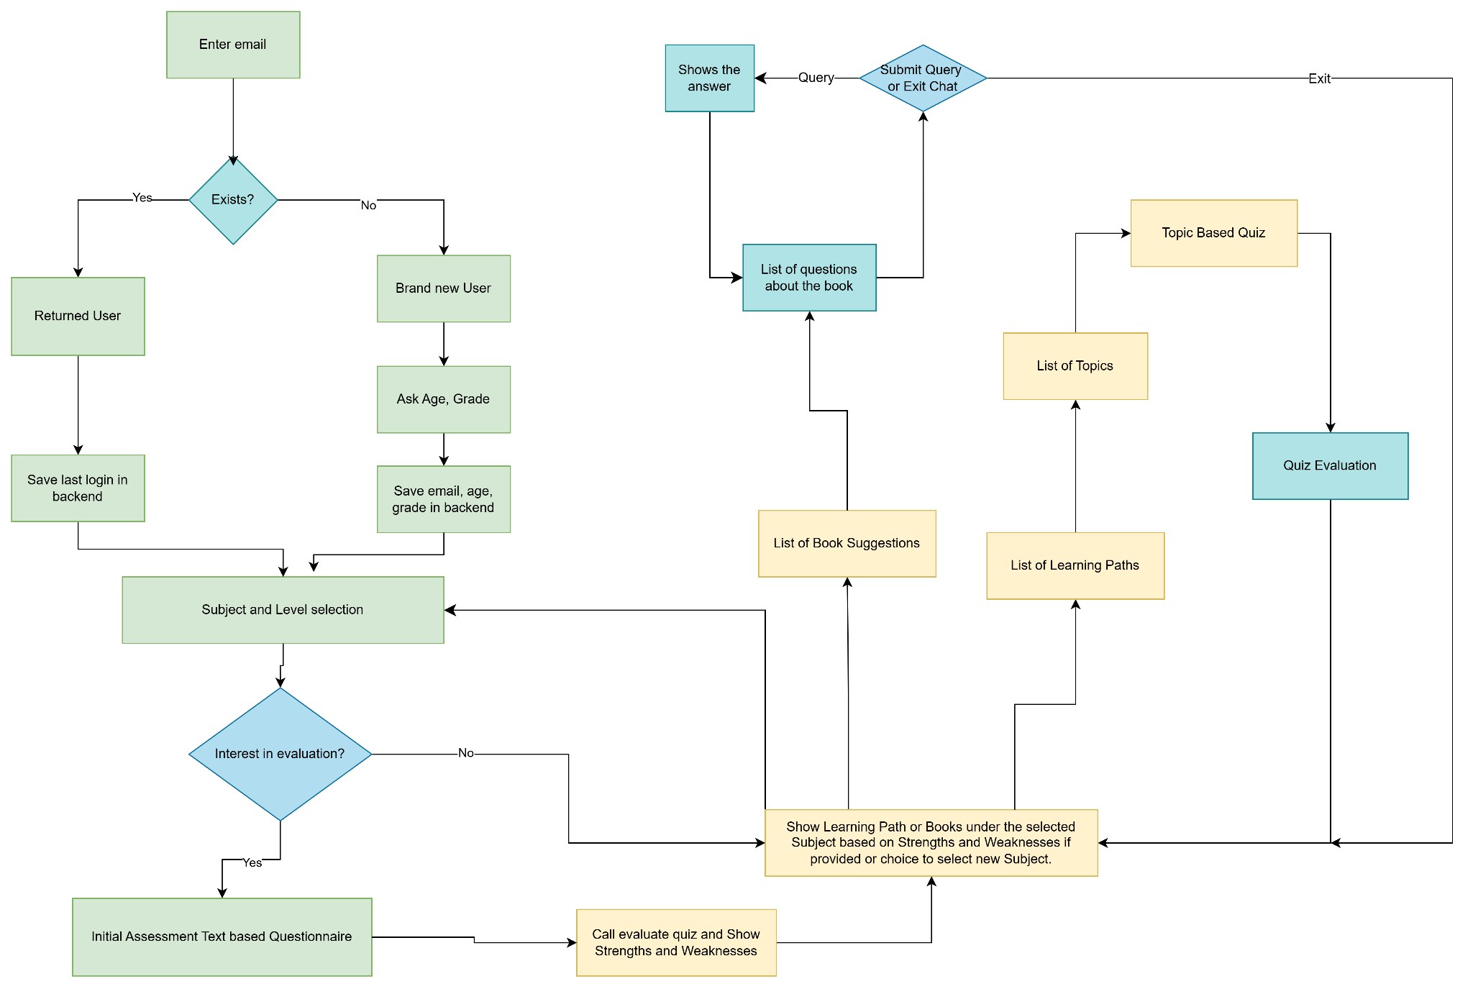
Flow Diagram Reference

Slide 10
Q & A

